Slide 1
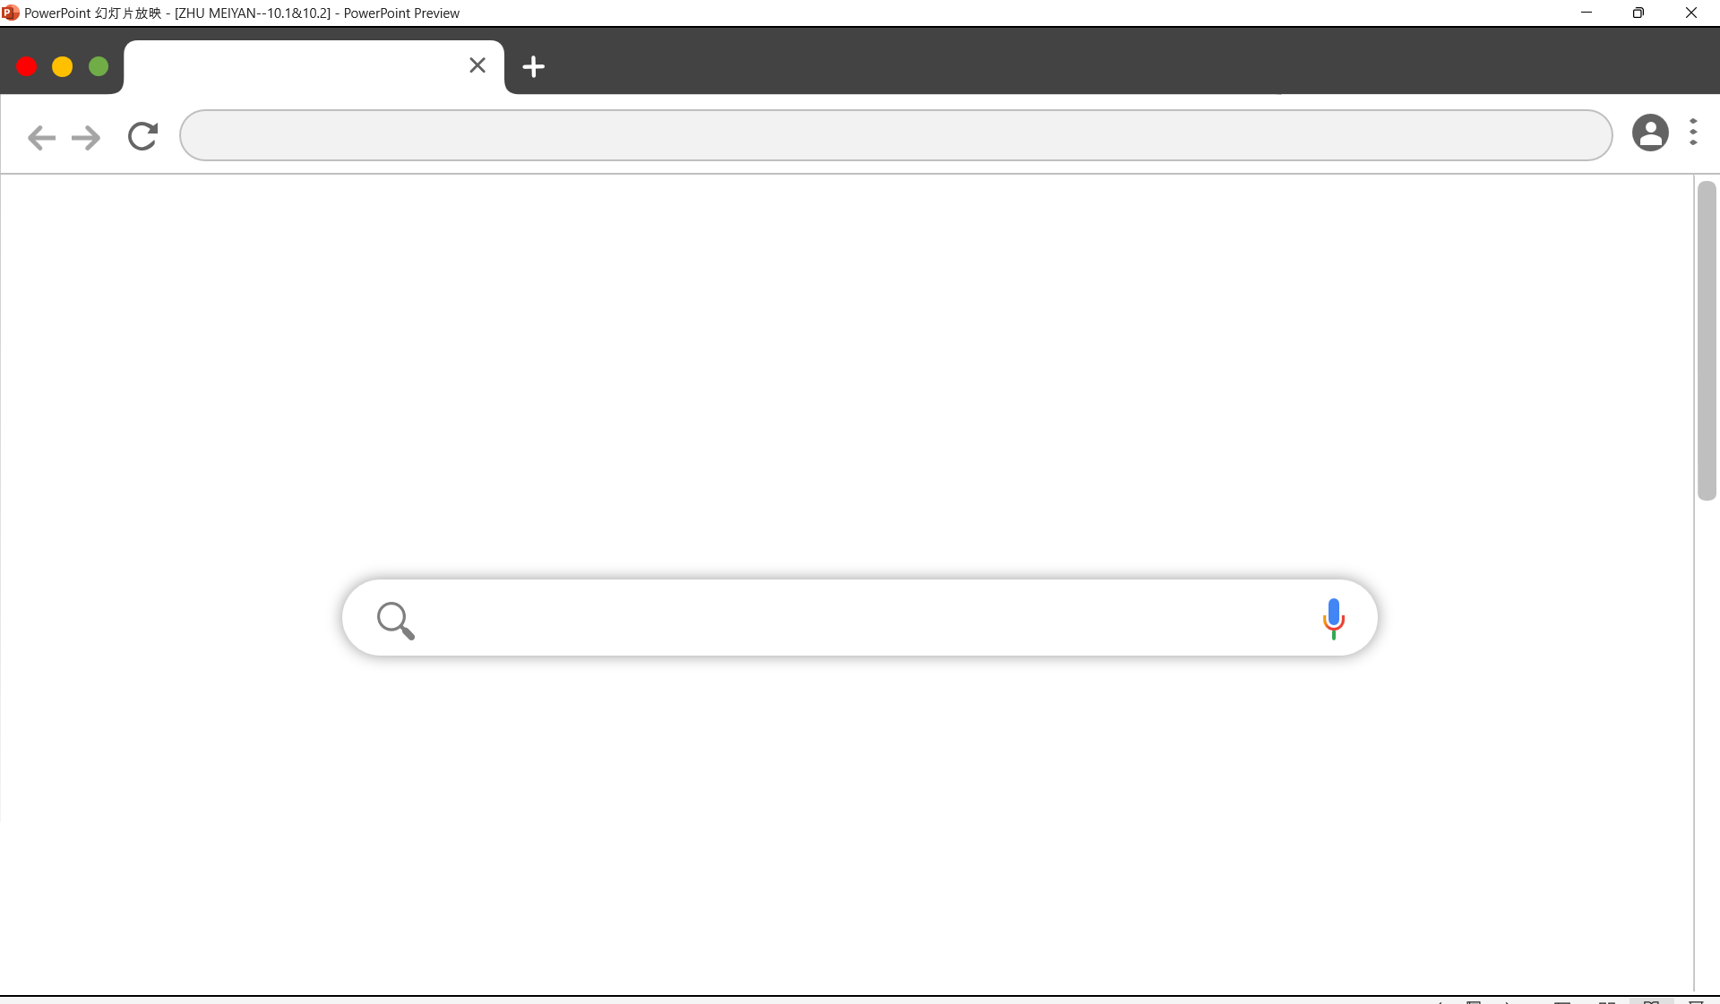
Mining Social-Network Graphs
10.1 Social Networks as Graphs 10.2 Clustering of Social-Network Graphs
ZHU MEIYAN / Clothing & Textiles

Slide 2
10.1 Social Networks as Graphs

Slide 3
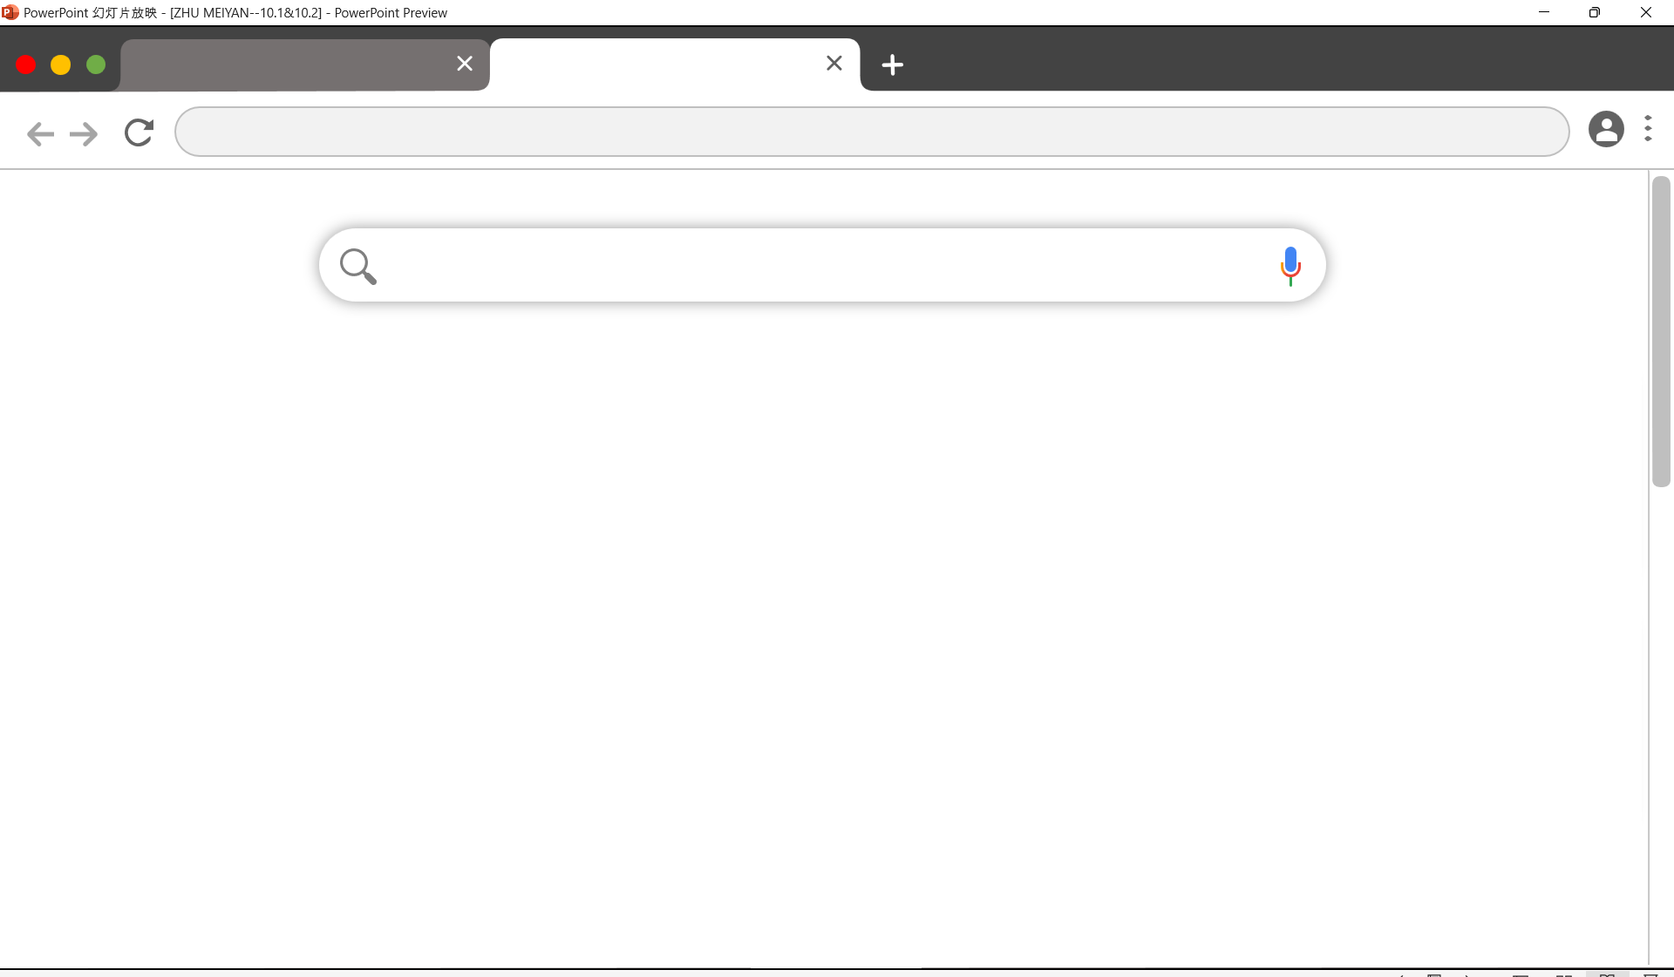
Mining Social-Network Graphs
10.1 Social Networks as Graphs
What is a Social Network?
A social network consists of:
Entities (nodes): typically individuals, but could include other entities like products or articles.
Relationships (edges): connections between entities, which might be binary (connected or not) or weighted (e.g., frequency of interaction)
Locality (non-randomness): relationships tend to cluster. If A is connected to both B and C, B and C are more likely to be connected.

Slide 4
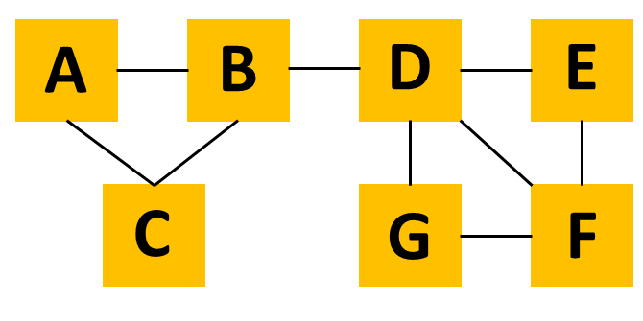
Mining Social-Network Graphs
10.1 Social Networks as Graphs
Social Networks as Graphs
Social networks are often represented as graphs, called social graphs, where nodes represent entities and edges represent relationships. If the relationships have degrees, they are labeled on the edges. Social graphs are typically undirected, like Facebook’s friends graph, but they can also be directed, such as Twitter or Google+ follower graphs.
an example of a tiny social network
The entities are the nodes A through G. The relationship, which we might think of as “friends,” is represented by the edges. For instance, B is friends with A, C, and D.

Slide 5
Mining Social-Network Graphs
10.1 Social Networks as Graphs
Examples of Social Networks
Telephone Networks: Nodes in a telephone network represent phone numbers. Edges connect numbers with call history, weighted by call frequency. Communities form among frequently communicating groups like friends, club members, or colleagues.
Email Networks: Nodes represent email addresses (individuals), and edges indicate email exchanges. Edges can reflect mutual communication or one-way communication, helping to distinguish spammers from genuine connections. Communities form similarly to those in telephone or texting networks, based on frequent interactions.
Collaboration Networks:
Author-Paper Networks: Nodes represent authors or papers. Authors are connected if they co-authored papers, forming communities based on shared research topics. Papers are connected if they share authors, creating communities of papers on similar topics.
Dual Networks in Other Contexts: Examples include Wikipedia editors and articles or customers and products. Editors are connected if they edit the same articles, forming communities by interest. Articles are connected if edited by the same people, forming topic-based groups. Similarly, customers and products can form networks for collaborative filtering: customers with similar preferences or products frequently bought together create communities.

Slide 6
Mining Social-Network Graphs
10.1 Social Networks as Graphs
Examples of Social Networks
Other Examples:
Many phenomena produce graphs resembling social networks, often exhibiting locality. Examples include information networks like documents, web graphs, and patents; infrastructure networks such as roads, air routes, water systems, and power grids; biological networks involving gene and protein interactions or food webs; and other types like product co-purchasing networks (e.g., Groupon).

Slide 7
Mining Social-Network Graphs
10.1 Social Networks as Graphs
Graphs With Several Node Types
Different Types of Graphs:
Collaboration networks often involve two types of nodes, such as author nodes and paper nodes, which form bipartite graphs (k=2).
Instead of simplifying the graph by removing one type of node, the full structure can be analyzed.
Example: Tagging Systems
Sites like del.icio.us involve three types of entities: users, tags, and web pages.
Users may be connected by shared tag usage or by tagging the same pages.
Tags may be linked by their appearance on the same pages or by being used by the same users.
Pages may be related through shared tags or users who tag them.

Slide 8
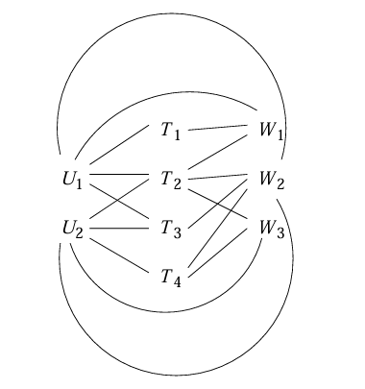

Mining Social-Network Graphs
10.1 Social Networks as Graphs
Graphs With Several Node Types
An example of a tripartite graph (the case k = 3 of a k-partite graph).
three sets of nodes:
Users: $\left\{U_{1},U_{2}\right\}$
Tags: $\left\{Τ_{1}, Τ_{2} {,Τ}_{3},Τ_{4}\right\}$
Web Pages: $\left\{W_{1},W_{2},W_{3}\right\}$
Notice that all edges connect nodes from two different sets. We may assume this graph represents information about the three kinds of entities.
Meaning of Edges:
An edge, such as($U_{1},T_{2}$) , represents that user $U_{1}$ has applied the tag $T_{2}$ to at least one web page.
Limitations:
This representation does not capture the specific details of which user applied which tag to which web page.
For a more detailed representation of such ternary relationships, a database-like structure with three columns (users, tags, and pages) would be needed.

Slide 9
10.2 Clustering of Social-Network Graphs

Slide 10
Mining Social-Network Graphs
10.2 Clustering of Social-Network Graphs
Distance Measures for Social-Network Graphs
Edge Labels as Distance Measures:
If graph edges have labels, these can sometimes be used as distance measures, depending on their meaning.
In unlabeled graphs (e.g., a “friends” graph), defining distance is more challenging.
Initial Approach to Distance:
A simple distance measure could assign:
0 if there is an edge between nodes (x,y).
1 if there is no edge.
Alternatively, values like 1 (for an edge) and ∞ (for no edge) can be used, as long as the distance is smaller when there is an edge.

Slide 11
Mining Social-Network Graphs
10.2 Clustering of Social-Network Graphs
Distance Measures for Social-Network Graphs
Problems with Two-Valued Distance Measures:
These measures violate the triangle inequality
Example: For three nodes (A,B,C), if edges(A,B) and (B,C) exist but (A,C) does not, the distance from A to C exceeds the sum of A→B and B→C.
To fix this, one could use values like 1 (for an edge) and 1.5 (for no edge).
Limitations Beyond the Triangle Inequality:
The issues with two-valued distance measures are not confined to the triangle inequality.

Slide 12
Mining Social-Network Graphs
10.2 Clustering of Social-Network Graphs
Applying Standard Clustering Methods
There are two main approaches:
hierarchical (agglomerative) and point-assignment.
For hierarchical clustering in a social-network graph, we can use the minimum distance between nodes of two clusters as the intercluster distance. The process begins by combining two connected nodes. Then, edges not within the same cluster are randomly chosen to merge the clusters connected by those edges. This randomness arises because all edge distances are equal in this context.

Slide 13
Mining Social-Network Graphs
10.2 Clustering of Social-Network Graphs
Applying Standard Clustering Methods
In this graph, we can identify communities at different levels.
At the highest level, there are two main communities: {A, B, C} and {D, E, F, G}. Within {D, E, F, G}, we can identify two overlapping subcommunities: {D, E, F} and {D, F, G}, which cannot be captured by a pure clustering algorithm due to the overlap.

Slide 14
Mining Social-Network Graphs
10.2 Clustering of Social-Network Graphs
Betweenness
Edge Betweenness:
The betweenness of an edge(a,b) is defined as the number of node pairs (x,y) for which the edge lies on the shortest path between x and y.
If there are multiple shortest paths between x and y, the edge is assigned a fractional score proportional to the number of shortest paths that include it.
Interpretation of Betweenness:
A high betweenness score indicates that the edge likely connects two different communities, meaning and belong to different groups.
Edges with high betweenness scores are often removed to separate the graph into communities.

Slide 15
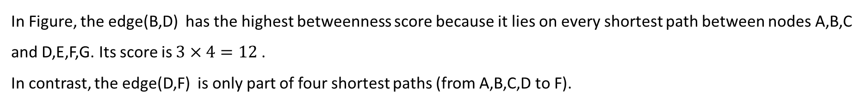
Mining Social-Network Graphs
10.2 Clustering of Social-Network Graphs
Betweenness
In Figure, the edge(B,D) has the highest betweenness score because it lies on every shortest path between nodes A,B,C and D,E,F,G. Its score is $3×4=12$ .
In contrast, the edge(D,F) is only part of four shortest paths (from A,B,C,D to F).

Slide 16
Mining Social-Network Graphs
10.2 Clustering of Social-Network Graphs
The Girvan-Newman Algorithm
Purpose of the Algorithm:
The GN algorithm determines the betweenness of edges by counting the number of shortest paths that pass through each edge in the graph.
Algorithm Overview:
The algorithm processes one node X at a time. It uses breadth-first search (BFS) starting from X to explore the graph and calculate shortest paths.
BFS and Node Levels:
The BFS assigns each node a level, which corresponds to the shortest path distance from the root node X. Edges connecting nodes at the same level are not part of any shortest path starting at X.
DAG Edges:
Edges between nodes at different levels are called DAG edges (Directed Acyclic Graph). These edges represent paths in the graph where one node (parent) is closer to the root and the other (child) is farther away.
Parent-Child Relationships:
If there is a DAG edge (Y,Z) where Y is one level above Z, Y is a parent of Z, and Z is a child of Y. Unlike in a tree, nodes in a DAG can have multiple parents.

Slide 17
Mining Social-Network Graphs
10.2 Clustering of Social-Network Graphs
Using Betweenness to Find Communities
Edge Betweenness as a Measure:
Betweenness scores for edges act somewhat like a distance measure between nodes, though they are not true distances.
They are undefined for unconnected node pairs and may not satisfy the triangle inequality.
Clustering by Adding Edges:
Edges are added in increasing order of betweenness scores.
At each step, the graph’s connected components represent clusters.
Allowing higher betweenness scores results in more edges and larger clusters.
Clustering by Removing Edges:
More commonly, clustering is done by removing edges with the highest betweenness scores.
This process continues until the graph breaks into a desired number of connected components, forming clusters.

Slide 18
Thanks for listening!

